Slide 1
BIP-PROJECT
DATA MINING 2020
Alessandro Contini
Enrico Voltan
Luca Cellamare

Slide 2
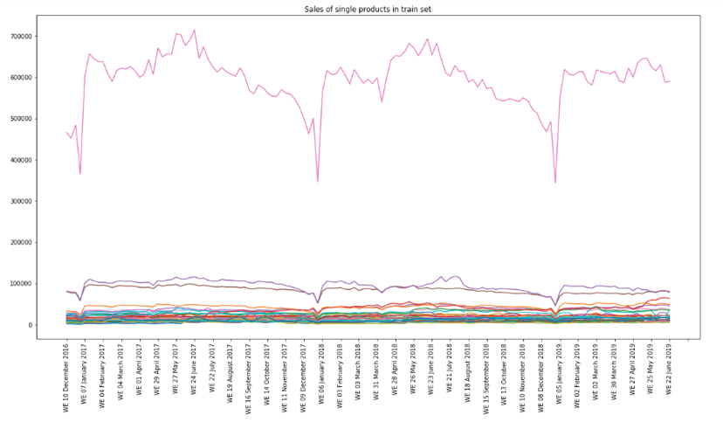
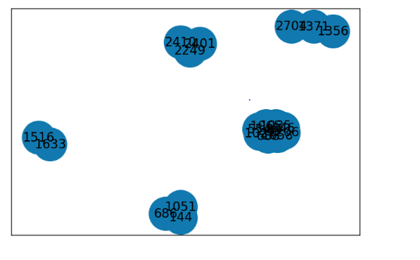
DATASET EXPLORATION

Slide 3
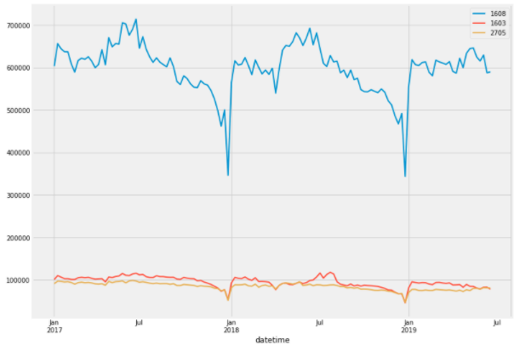
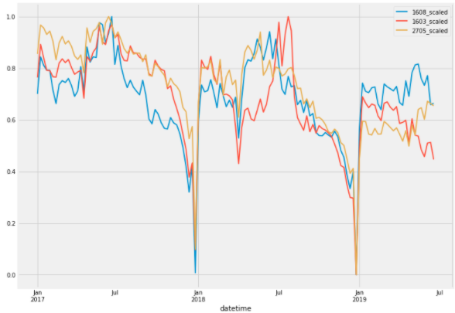
APPEARANCES CAN BE DECEPTIVE

Slide 4
OUR SOLUTIONS: AVERAGING AND STACKING
XGBOOST
fit train -> predict test
XGBOOST
cross predict train and predict test
RANDOM FOREST
fit train -> predict test
AVERAGE PREDICTIONS
RANDOM FOREST
fit train predictions -> predict test predictions
EXTRA TREES
fit train -> predic test
EXTRA TREES
cross predict train and predict test

Slide 5
THANK YOU FOR YOUR ATTENTION

